Slide 1
About USA Networks
Audience primarily includes 20’s – 50’s
Ranked among the top five basic cable channels for viewing popularity

Slide 2

Strengths
Established brand as the top channel
Innovative exclusive content
Characters unite: Social Cause

Slide 3
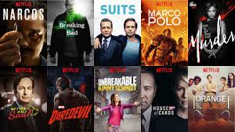
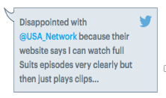

Weaknesses
Losing fan following and viewership
High social media costs
Less focus on comedy shows

Slide 4
Threats
Strength of competitors
Increasing interest in digital media
Uncertainty in social media success

Slide 5
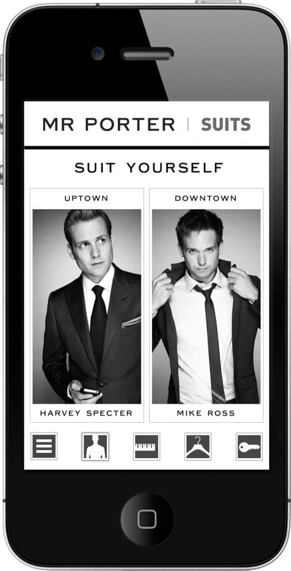

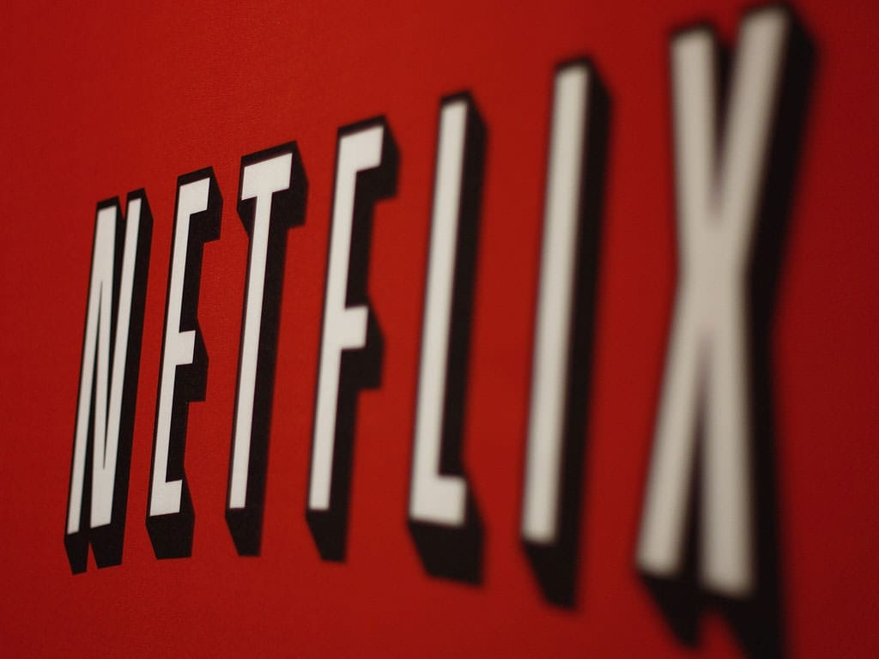
Opportunities
Focus on latest trends: Fashion
Organize events for viewers
Capitalize on growing streaming market

Slide 6


Positioning Strategy
High Viewership
Negative Brand Image
Positive Brand Image
Low Viewership

Slide 7
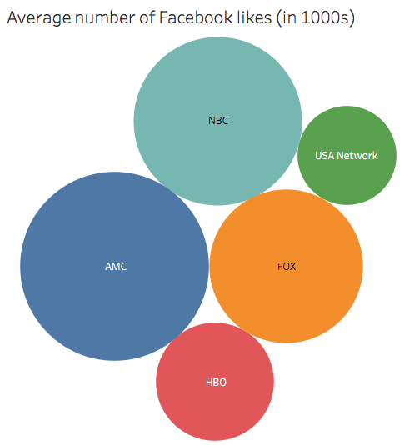
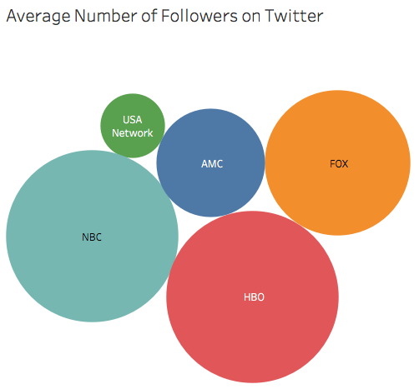

Slide 8
